Slide 1

CMR COLLEGE OF ENGINEERING & TECHNOLOGY
Kandlakoya, Medchal, Hyderabad - 501401
Department of Computer Science and Engineering
Blockchain Empowered Device Based Voting
Batch No.: 56
Under esteemed guidance of
Guide Name
Ch. Raj Kishore
Associate Professor
Name of the student:
Galla Nitin 20H51A05N6
Lokini Navya 20H51A05E6
Kalapala Nithya Sri 20H51A05N9
Batch: 2020-2024 Major Project Phase 1

Slide 2
Outline
Abstract
Introduction
Research Objective
Problem Definition
Scope of the Project
Literature Review
Implementation of Existing system
Conclusion
References
Notes:
2

Slide 3
Abstract
Notes:
3

Slide 4
ABSTRACT
Blockchain Empowered Device Based Voting introduces a safer way to vote using new technologies using one’s own device from their home. We all know voting is important, but sometimes it's not a secure as we'd like. Our approach leverages both fingerprint and blockchain technology for enhanced security and accountability. Blockchain acts like an unbreakable digital vault for votes. Each vote is locked in, impossible to alter. But we didn't stop there. We have incorporated an additional layer of safeguarding through fingerprint authentication. Just like unlocking your phone, only you can cast your vote, making the process ultra-secure. We aim to create a user-friendly web application/app that effortlessly adapts to different devices, ensuring a seamless and intuitive experience. Upon casting your vote, your fingerprint is authenticated, and your vote is saved in the blockchain infrastructure. This makes sure your vote is private and free from tampering and manipulation. This project makes voting better and safer. By using these new ideas, we're making sure that voting is honest and fair for everyone. .

Slide 5
INTRODUCTION
Notes:
5

Slide 6
Introduction
In an era of paramount importance for secure and reliable voting systems, our Blockchain Empowered Device-Based Voting presents a transformative solution.
Traditional voting methods face concerns related to security and tampering, which our approach tackles by leveraging blockchain technology, creating an incorruptible digital repository for each vote.
Our system stands out with the integration of fingerprint authentication, adding an extra layer of individualized security, ensuring that only the rightful voter can cast their ballot.
This dual-layered security mechanism guarantees the integrity of the voting process and the privacy of each individual's choice.
Our vision extends to delivering a user-friendly web application/app that seamlessly adapts to various devices, making the voting experience intuitive and effortless, all while maintaining robust security features.
Each vote cast, authenticated by a unique fingerprint, becomes an immutable part of the blockchain infrastructure, safeguarding the privacy of each vote and the entire electoral process from potential tampering or manipulation.
Ultimately, our project redefines the voting landscape, ushering in an era of honesty, fairness, and confidence in the democratic process.
Notes:
6

Slide 7
Research Objective
Notes:
7

Slide 8
Research objective
Investigate and develop a comprehensive understanding of the Blockchain Empowered Device Voting system.
Assess the feasibility and efficacy of this system in enhancing the security and accessibility of the voting process.
Conduct rigorous analysis and testing to evaluate the integrity and reliability of blockchain technology in safeguarding votes.
Evaluate the usability of fingerprint authentication for ensuring the authenticity of voters.
Design and implement a user-friendly web application/app that adapts seamlessly to various devices.
Ensure a convenient and intuitive experience for voters in the voting process.
Provide valuable insights into the potential of this innovative voting solution to address challenges of security and accessibility in the electoral system.
Contribute to the promotion of more honest and equitable elections.
Foster greater civic engagement in the electoral process.

Slide 9
Problem Definition
Notes:
9

Slide 10
Problem Definition
The traditional voting system faces significant challenges, including security vulnerabilities and accessibility limitations. These methods often struggle to ensure the security and confidentiality of votes, creating opportunities for manipulation and fraudulent activities.
Moreover, the requirement for physical presence at polling stations can hinder participation, especially for individuals with mobility issues or those in remote locations. To tackle these pressing issues, the Blockchain Empowered Device Based Voting project aims to introduce a secure and user-friendly voting solution by harnessing blockchain technology and fingerprint authentication. This initiative seeks to transform the voting experience, enhancing its safety, transparency, and inclusivity, allowing voters to conveniently cast their ballots from their own devices. The project is dedicated to bolstering the reliability and accessibility of the electoral process, ensuring that voting remains a fundamental aspect of democratic societies.

Slide 11
Scope of the Project
Notes:
11

Slide 12
Scope of the Project
Our main goal in this project is to improve the voting process's security and accessibility through the design, development, and evaluation of a Blockchain-powered device-based voting system.
Our aim is to develop an application that is easy to use and adaptable to multiple devices. We will prioritize features like security, integrity, and convenience of use. In-depth testing will be done as part of this research to determine how well fingerprint authentication and blockchain technology work together to secure votes and confirm voter identity. The review method will include both technical and user experience components, with the goal of offering in depth insights into the system's ability to improve the voting process.

Slide 13
Literature Review
Notes:
13

Slide 14
Comparison table for the existing system
 | Authors and Journal Name& Year of publication | Problem Statement | Name of the Proposed solution/Method | Solution | Remarks
1 | Uzma Jafar, Mohd Juzaiddin Ab Aziz, and Zarina Shukur. Sensors (Basel) PMC8434614 2021 Aug 31 | Online voting is popular but risky. Regular voting isn't very secure. Blockchain might help, but there are privacy and speed issues. | Blockchain for Electronic Voting System—Review and Open Research Challenges | The solution involves refining blockchain applications to address privacy concerns and transaction speed. Improving the existing frameworks is crucial for a secure and efficient online voting system | As a username, blockchain utilizes pseudonyms. This strategy does not provide complete privacy and secrecy. Because the transactions are public, the user’s identity may be discovered by examining and analyzing them. The blockchain’s functionality is not well suited to national elections
2 | Syada Tasmia Alvi a, Mohammed Nasir Uddin b, Linta Islam b, Sajib Ahamed b 2022 | The traditional voting system faces issues with transparency, security, and accessibility, including booth capture, dummy voting, and challenges for older voters. Electronic Voting Machines (EVMs) have their limitations. | DVTChain : A blockchain-based decentralized mechanism to ensure the security of digital voting | A blockchain-based voting system is proposed. It utilizes Ethereum's smart contracts for automation, improving security, privacy, verifiability, and fairness. | The proposed solution leverages tools like Truffle, Solidity, Ganache, and a Node server for development and testing.
3 | Haibo Yi. 2019 | Transition to online electronic voting (e-voting) driven by technology raises security, privacy, and accessibility challenges. | Securing e-voting based on blockchain in P2P network | Blockchain-based e-voting enhances security and transparency with synchronized records to avoid forgery, ECC-based user credentials, and a voter withdrawal option.. | The proposed e-voting system offers security enhancements, authentication, and transparency. Challenges include accessibility, regulatory hurdles, building public trust, technical infrastructure, and privacy concerns.

Slide 15
Comparison table for the existing system
S.No | Authors and Journal Name& Year of publication | Problem Statement | Name of the Proposed solution/Method by authors | Solution | Remarks
4 | Akhil Shah Nishita Sodhia Shruti Saha Soumi Banerjee Madhuri Chavan 2020 | The problem addressed in this research is the lack of trust in election systems and the flaws in existing voting methods, including vote rigging, EVM hacking, polling booth capture, and election manipulation. | Blockchain Enabled Online-Voting System | The proposed solution is an Ethereum blockchain-based online voting system ensuring secure, anonymous, and efficient voting. It establishes tamper-proof voter wallets with user credentials, issues voting tokens, and maintains the integrity of the voting process for reliable results. | It highlight a cost-effective, secure online voting system using blockchain, enhancing accessibility and addressing security concerns. It aims to improve the efficiency and trustworthiness of voting systems, overcoming current challenges.
5 | Linh Vo-Cao- Thuy Khoi Cao-Minh, T. A. 2019 | The problem addressed in the paper is the need for a secure, fair, and transparent electronic voting (E-voting) system. The existing traditional voting methods are susceptible to issues like tampering, manipulation, and lack of transparency. | Votereum: An Ethereum-Based E-Voting System | The solution uses blockchain technology, particularly Ethereum, to establish a secure and transparent E-voting system. It employs smart contracts for elections, voter registration, and a privacy-focused voting process, addressing trust, fairness, and transparency concerns in the electoral process. | The paper evaluates the proposed Votereum system, emphasizing its potential to enhance the electoral process using blockchain technology. It tackles privacy, transparency, and security issues in voting. Votereum serves as a blockchain-based E-voting prototype, leaving opportunities for future development and practical use.

Slide 16
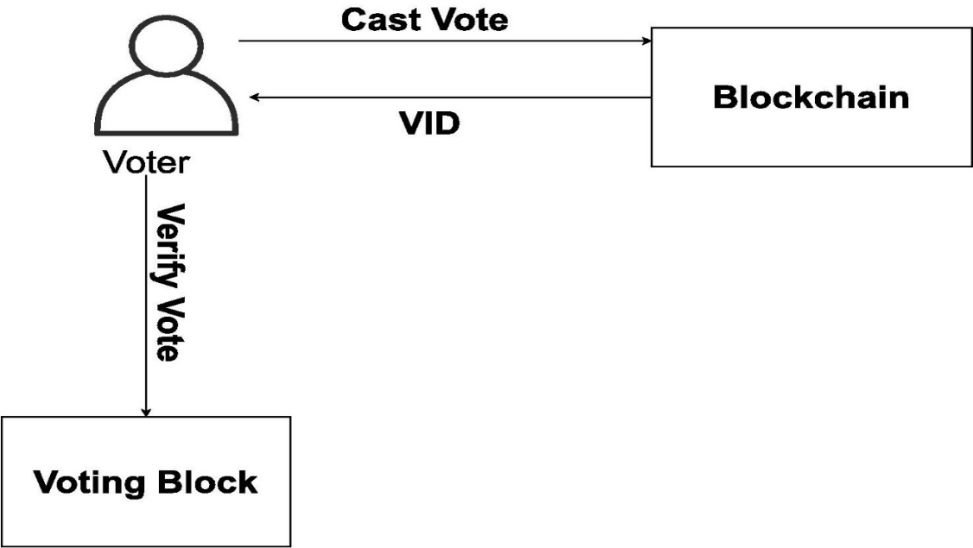
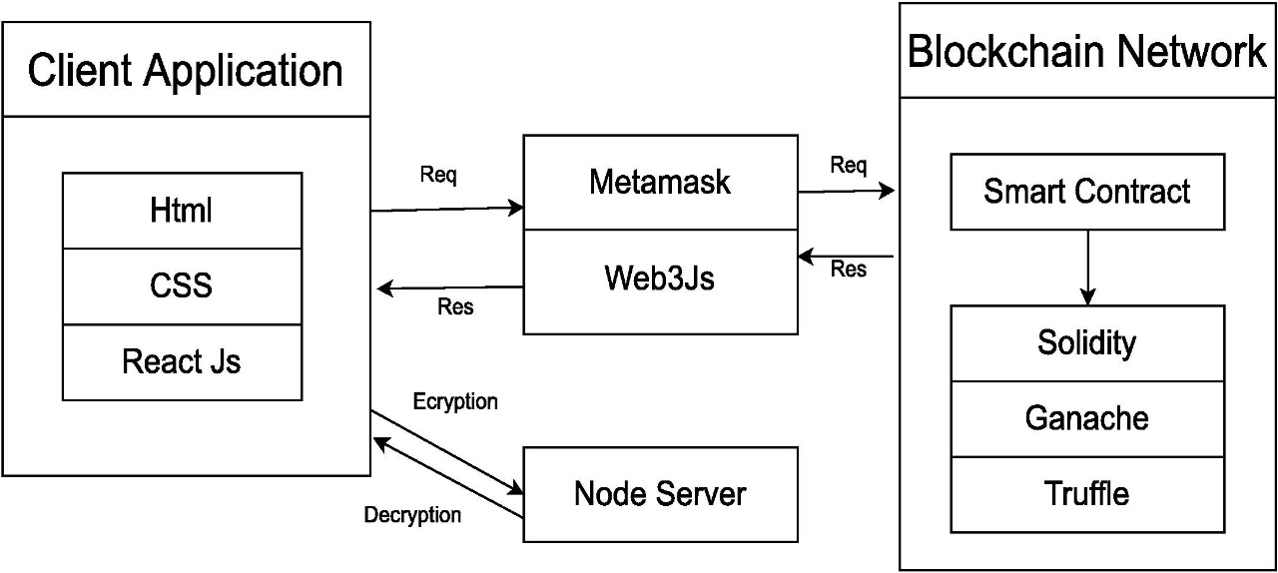
Implementation of Existing System
The Ethereum blockchain enables secure and automated voting through smart contracts, requiring user input to execute operations, and employs tools like Truffle, Solidity, Ganache, and a Node server to manage and secure the system.

Slide 17
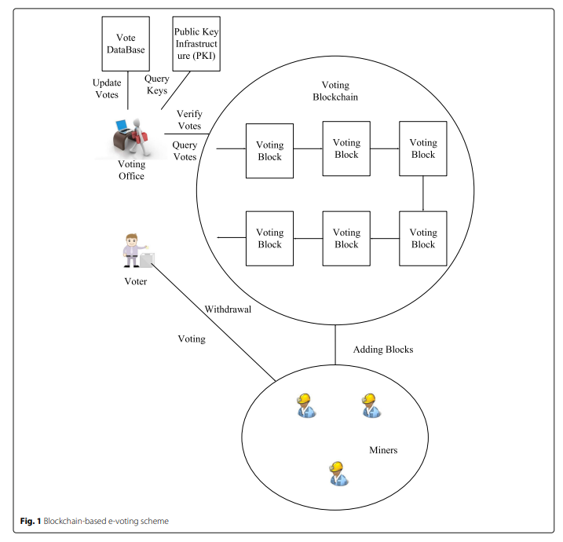
Implementation of Existing System
A blockchain-based e-voting scheme featuring a synchronized voting records model, user credential system using ECC, withdrawal option, and mining of voting blocks to enhance security and transparency in electronic voting.

Slide 18
Result
The result of this abstract is an innovative and secure voting system that combines blockchain technology and fingerprint authentication. The aim is to address existing concerns about the security and integrity of traditional voting methods. By utilizing blockchain as an unalterable digital vault for votes and incorporating fingerprint authentication, the system ensures an ultra-secure and tamper-proof voting process. The user-friendly web application/app adapts seamlessly to different devices, providing an intuitive and effortless voting experience. The end result is a transformative approach to voting, making it better, safer, and fostering honesty and fairness in the democratic process.

Slide 19
Conclusion
Research goal: Analyze and evaluate current research on blockchain-based electronic voting systems.
Existing electronic voting research: Discuss recent developments using blockchain technology.
Deficiencies in current systems: Identify and address issues in current electronic voting systems.
Blockchain's potential: Highlight its potential to enhance electronic voting.
Transparency: Emphasize that voters and impartial observers can access voting records.
Challenges to address: Mention potential drawbacks like scalability attacks and lack of transparency.
Future research directions: Outline possible paths for further research.
Uncertainty: Acknowledge that more research is needed to understand risks in blockchain-based electronic voting systems.

Slide 20
References
[1] Liu Y., Wang Q. An E-voting Protocol Based on Blockchain. IACR Cryptol. Eprint Arch.
2017;2017:1043. [Google Scholar]
[2]Shahzad B., Crowcroft J. Trustworthy Electronic Voting Using AdjustedBlockchainTechnology. IEEE Access. 2019;7:24477–24488. doi: 10.1109/ACCESS.2019.2895670. [CrossRef] [Google Scholar]
[3]. Racsko P. Blockchain and Democracy. Soc. Econ. 2019;41:353–369. doi: 10.1556/204.2019.007. [CrossRef] [Google Scholar]
[4]. Yaga D., Mell P., Roby N., Scarfone K. Blockchain technology overview. arXiv. 20191906.11078 [Google Scholar]
[5]. The Economist EIU Democracy Index. [(accessed on 18 January 2020)];2017 Available online: https://infographics.economist.com/2018/DemocracyIndex/

Slide 21
Thank You!

